Slide 1
Resolving: Can People Accurately Self-Assess Their Competence?
Edward Nuhfer (California State University - retired)
Karl Wirth (Macalester College)
Steven Fleisher (California State University - Channel Islands)
Christopher Cogan (Private Consultant)
Eric Gaze (Bowdoin College)

Slide 2
When people convey that they know something, do they?

Slide 3
What do we bring ...?
SHOW OF HANDS! How many of us...
Have heard of the “Dunning-Kruger Effect?”
Believe that most people severely overestimate their actual competence?
Believe that we can self-assess better than our students do?

Slide 4
To investigate accuracy of self-assessment
We need a good quantitative measure of demonstrated competence (in percentages).
We need a good quantitative measure of self-assessed competence (in percentages.)
We need good alignment of the two measures.
We need a respectably sized database
(Self-assessed competence minus Demonstrated competence) = Inaccuracy (in percentage points - ppts)
Overconfidence = positive (+) ppts
Underconfidence = negative (-) ppts
Perfect self assessment = zero (0)

Slide 5
Our study used paired instruments
Actual Competence: 25-item Science Literacy Concept Inventory (SLCI) (see Nuhfer et al. JMBE March 2016 on 17,000 student study)
Test reasoning, not factual knowledge.
Score in percentage points
Reliability = .84 (Cronbach’s alpha)
Self-Assessed Competence: Knowledge Survey of the SLCI (the KSSLCI)
Uses same 25 items as the SLCI
Ratings in percentage points
Reliability = .93 (Cronbach’s alpha)
Instruments well-aligned by use of identical items
Self Assessment Inaccuracy = (KSSLCI-SLCI) ppts
N = 1154 participants – some results already published in the journal Numeracy, Jan. 2016.

Slide 6
Three working hypotheses:
Measures of self-assessed competence yield mostly random noise and have no meaningful relationship with demonstrated competence.
Most people are unskilled and unaware of it and have a strong propensity toward overestimating their abilities.
Most people's self-assessed competence is generally in accord with direct measures of their competence.
Behavioral scientists currently favor the second hypothesis.

Slide 7
Self-assessments are just noise...
… if the critics are correct, and students lack the cognitive ability to accurately answer most survey questions, then the critics are, in essence, arguing that students must be generating random self-assessment responses to survey (Porter 2013, p. 202).
Theoretical models of cognition, and empirical evidence to date demonstrate that self-reported learning gains are mostly noise and cannot be used to assess student learning (Porter, 2012, p. 6).
The National Survey for Student Engagement (NSSE) is largely self-reported data

Slide 8
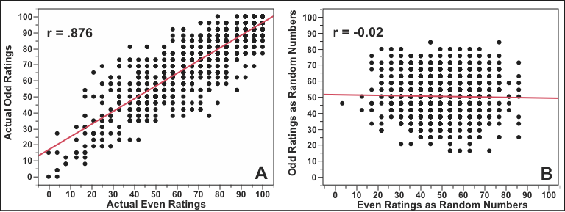
Hypothesis 1 (random noise) refuted on the basis of reliability...
Reliability

Slide 9
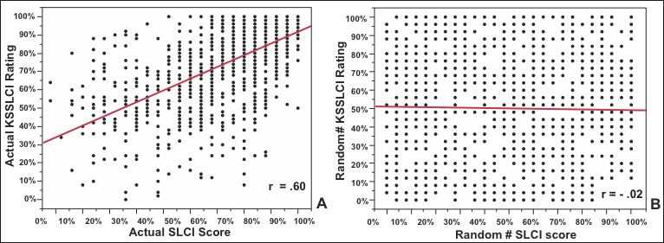
...and correlation (2)
Correlation: Competence (SLCI) vs. Confidence (KSSLCI)

Slide 10
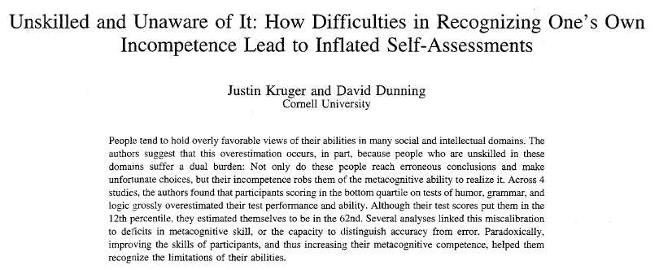
Hypothesis 2: 1999 seminal paper
First serious effort to quantify self-assessment!
First to demonstrate self-assessment is teachable.

Slide 11
The Dunning-Kruger effect
The Dunning–Kruger effect expresses that relatively unskilled people suffer illusory superiority and mistakenly assess their abilities to be much higher than they really are.
Conversely, persons with high ability tend to underestimate their relative competence.

Slide 12
Consensus built over time...
People are typically overly optimistic when evaluating the quality of their performance on social and intellectual tasks. In particular, poor performers grossly overestimate their performances because their incompetence deprives them of the skills needed to recognize their deficits (Ehrlinger et al. 2008).

Slide 13
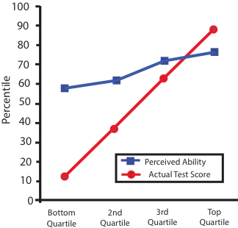
Dunning-Kruger Effect in a K-D Graph
This graphic type from 1999 (Kruger & Dunning) remains in use to present.

Slide 14
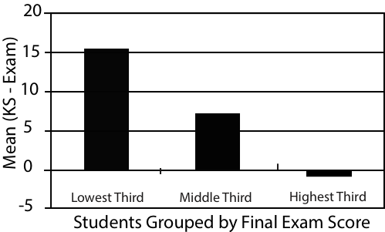
Dunning-Kruger effect in a chemistry class displayed as a column graph
From Bell and Volckmann 2011

Slide 15
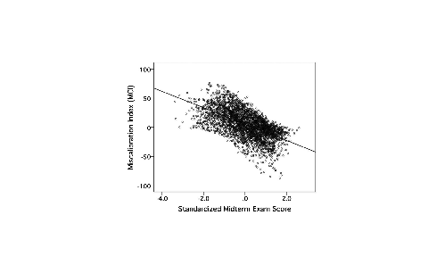
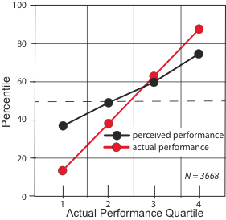
A look behind the Kruger-Dunning graphic...
From Pazicni and Bauer. 2013
r = - .59
Note the (y-x) vs. (x) format.

Slide 16
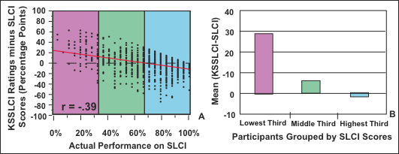
And behind the column graphs
Note again the (y-x) vs. (x) format.

Slide 17
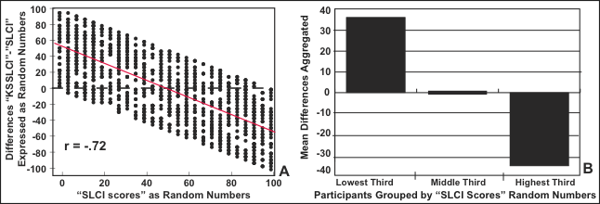
What if we replace real data with random numbers (i.e. noise--nonsense)?
In all (y-x) vs (x) type graphics, random noise produces the apparent overconfidence of the unskilled and underconfidence of the highly skilled.

Slide 18
A Different Approach
Use categorical data rather than sorted data aggregated into quartiles.
This yields (y - x) vs. categories instead of
(y - x) vs. (x) type graphs.

Slide 19
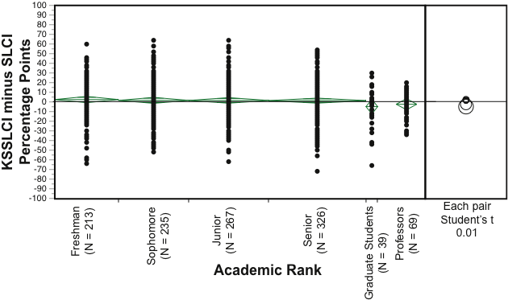
Results from Categorical Data
If Hypothesis 2 is correct, should see novices overestimating and experts underestimating.

Slide 20
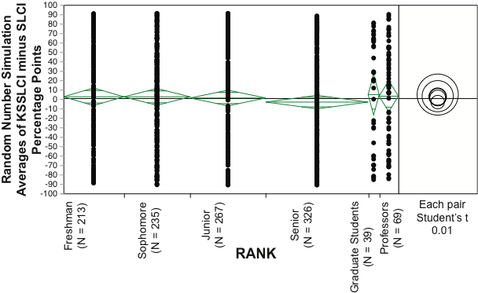
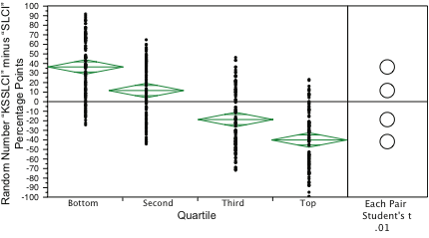
Categorical Data vs. Sorted Data as Random Numbers
Categorical data, simulated as random numbers, show no significant differences by means in aggregate. Minor, if any, ceiling effect.
Sorted data, simulated as random numbers, reveals that sorting creates significant difference as an artifact. This indicates that “unskilled and unaware
of it” could result from interpreting the artifact as human behavior.

Slide 21
Experts and Novices. We see differences in data spreads, but not means.

Slide 22
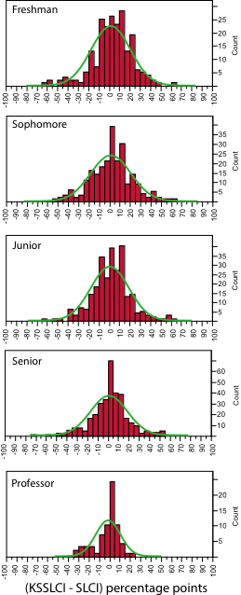
Variance = 361
Experts group tighter around perfect self- assessment (zero) than do novices.
Variance = 383
Variance = 379
Variance = 318
Variance = 143

Slide 23
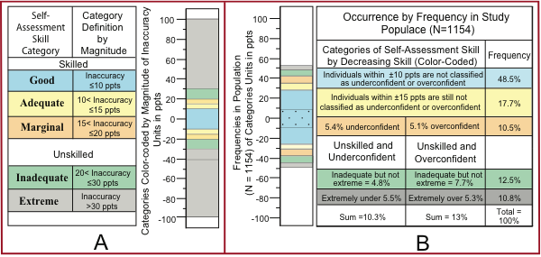
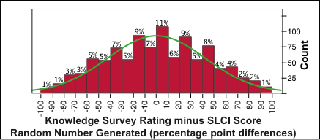
Use Categorical Knowledge to Construct a Self-Assessment Scale
Up to 18% of our good (±10 ppts) self-assessments (see dots in B) can be credited to random probability, which, with 100% of participants random guessing, produces a random distribution when generating differences of two arrays with ranges from 0 to 100.

Slide 24
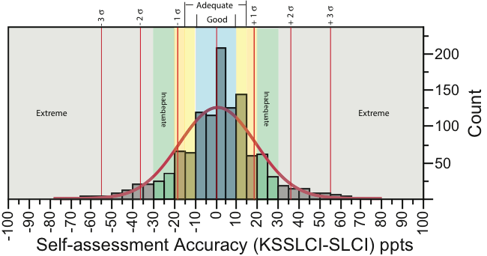
About ½ self-assess within ±10% About ¾ self-assess within ±20%

Slide 25
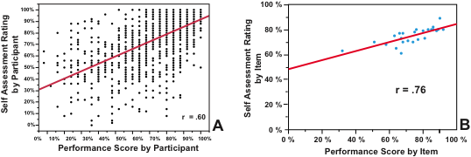
Correlations are strong between competence and confidence on the basis of participant-by- participant (A) and Item-by-Item (B)
Both the table produced by differences and the correlations here indicate that, more often than not, most peoples’ self assessments are generally in accord with their capabilities. Aggregated data on self-assessed competence offers a useful and valid assessment of competence.

Slide 26
Conclusions
Those “unskilled and unaware of it” constitute a minor portion (~ 5%) of people.
In general, individual’s self-assessments reflect their competence.
In aggregate item-by-item, self-assessed competence and demonstrated competence correlate strongly .

Slide 27
END

Slide 28
Bone Pile Slides

Slide 29
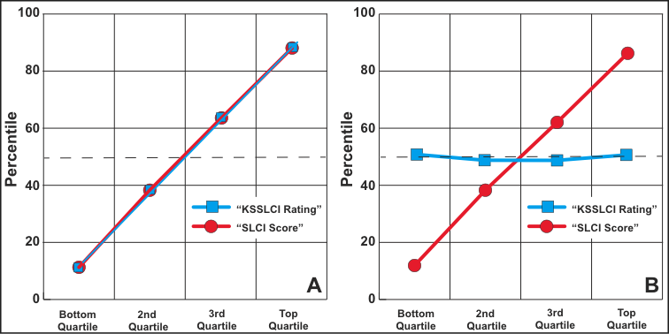
End Members: 100% Signal & 100% Noise

Slide 30
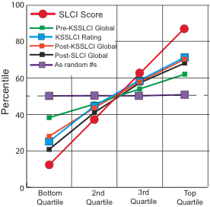
Differing Mixtures: Noise and Signal

Slide 31
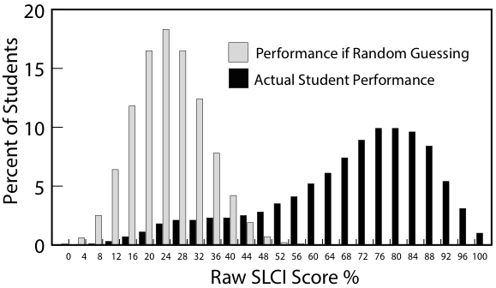
Testing for Random Guessing

Slide 32
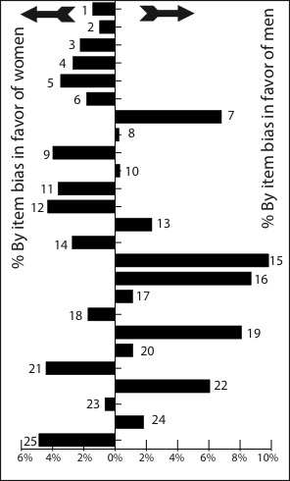
Even though more than half of the items appear biased in favor of women, women exhibit lower confidence on all 25 items...

Slide 33
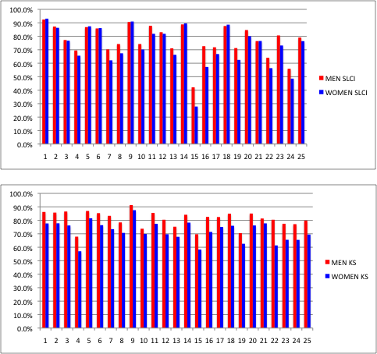
Relationships between
Item-by-Item SLCI Scores and KSSLCI Ratings by Gender
SLCI
M vs W
r = .98
Women N = 898
Men N = 501
Each: Men
and Women
SLCI vs. KSSLCI
r = . 76
M vs W
r = .91
KSSLCI

Slide 34
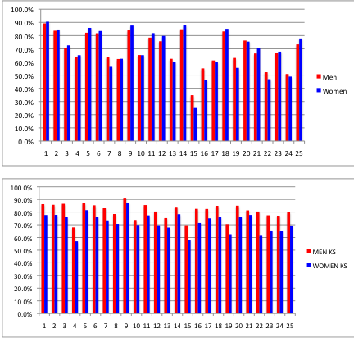
Relationships between
Item-by-Item SLCI Scores and KSSLCI Ratings by Gender
SLCI
M vs. W
r = .98
Women N = 13692
Men N = 8203
Each: Men
and Women
SLCI vs. KSSLCI
r = . 76
Women N = 898
Men N = 501
KSSLCI
M vs. W
r = .91

